Slide 1
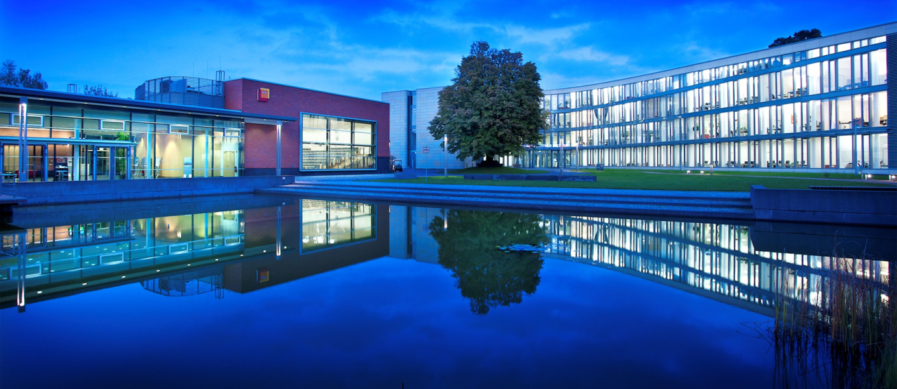
Erste Woche
Johannes Eschrig, Sven Knebel, Nicco Kunzmann
MP P1 2015
Hasso-Plattner-Institut Potsdam

Slide 2
HP Helion
HP’s OpenStack based cloud system
Virtual installation (https://docs.hpcloud.com/helion/community/install-virtual/)
demonstration release to test the functionality of HP Helion
required:
At least 64 GB of RAM (Works on 16GB in talk from Chris Cannon)
At least 200 GB of available disk space
Baremetal installation (https://docs.hpcloud.com/helion/community/network-requirements/)
baremetal multi-node deployment for a small-scale cloud
installation system (seed cloud host) requires:
At least 64 GB of RAM
At least 200 GB of available disk space
https://docs.hpcloud.com/helion/community/install-overview

Slide 3
OpenStack Dienstliste
Service | Project | Description
Dashboard | Horizon | Web-based self-service portal to interact with underlying OpenStack services
Compute | Nova | Manages the lifecycle of compute instances in an OpenStack environment
Networking | Neutron | Enables Network-Connectivity-as-a-Service for other OpenStack services, such as OpenStack Compute.
Object Storage | Swift | Stores and retrieves arbitrary unstructured data objects via a RESTful, HTTP based API.
Block Storage | Cinder | Provides persistent block storage to running instances.
Identity Service | Keystone | Provides an authentication and authorization service.
Image Service | Glance | Stores and retrieves virtual machine disk images.
Telemetry | Ceilometer | Monitors and meters the OpenStack cloud for billing, benchmarking, scalability, and statistical purposes.
http://docs.openstack.org/admin-guide-cloud/content/ch_getting-started-with-openstack.html

Slide 4
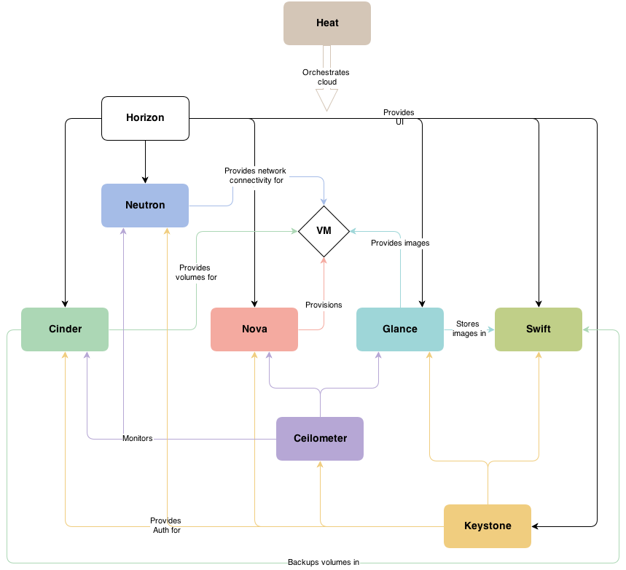

Slide 5
Nested Virtualization
Mit Linux unter KVM
Dokumentation für RedHat, aber inzwischen recht lange im Kernel → sollte unter Ubuntu auch funktionieren

Slide 6
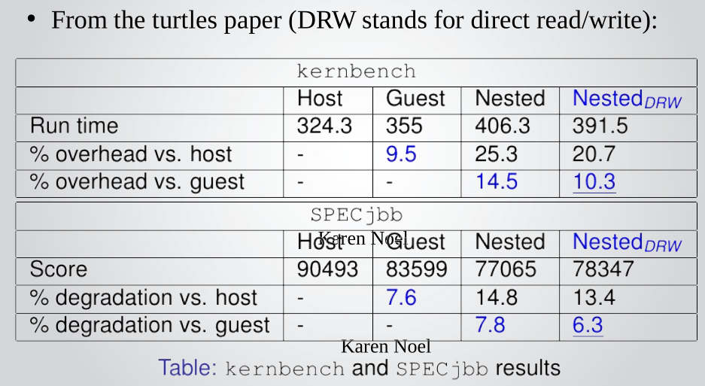
Nested Virtualization
http://www.linux-kvm.org/wiki/images/e/e9/Kvm-forum-2013-nested-virtualization-shadow-turtles.pdf

